Slide 1



Image Caption Generator
G.H. Raisoni College of Engineering
Bachelor of Technology in Information Technology
Under the Guidance of
Prof. Priti Kakde
Department of Information Technology
GHRCE, Nagpur
Presented by :
Chandrakant Dhule - 48

Slide 2

Introduction
Automatically describing the content of images using natural languages.
In this an Image caption generator, Basis on our provided image It will generate the caption from our trained model.
A computer system takes input images as two-dimensional arrays and mapping is done from images to captions or descriptive sentences.
For example, it could help visually impaired people better understand the content of images on the web.

Slide 3

Objective
Automated Captioning: Develop a system that can automatically generate descriptive captions for a wide range of images.
Future Development Possibilities: Create a foundation for future enhancements.
Deep Learning Integration: Utilize Convolutional Neural Networks (CNNs) to extract relevant features from images and Long Short-Term Memory (LSTM) networks for generating coherent and contextually relevant captions.
User-Friendly Interface: Design and develop a user-friendly interface that allows users to input images and receive generated captions in real-time.

Slide 4

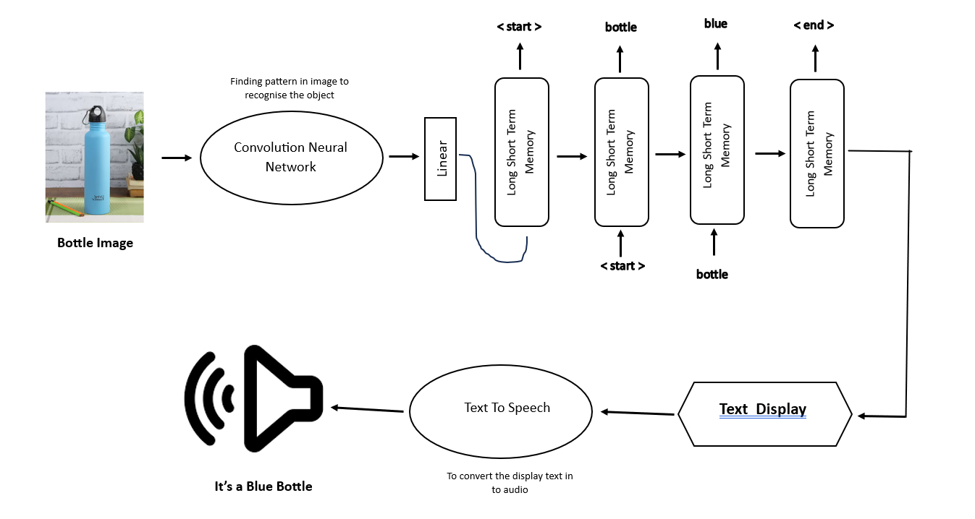

Slide 5

Methodology
Data Collection and Preprocessing:
Gather a diverse dataset of images paired with corresponding human-generated captions.
Feature Extraction using CNNs:
Utilize a pre-trained Convolutional Neural Network (CNN) (e.g., VGG16, ResNet) to extract meaningful features from images.
Text Generation using LSTM:
Employ Long Short-Term Memory (LSTM) networks for text generation.

Slide 6
Methodology
Model Architecture:
Design the overall architecture by combining the image features and LSTM-generated text.
Training and Optimization:
Train the model using the prepared dataset, feeding it with image features and ground truth captions.
Fine-Tuning and Iteration:
Fine-tune the model based on user feedback and generated captions to improve caption quality over time.

Slide 7
PROPOSED SYSTEM: APPROACH: The overall workflow can be divided into these main steps: 1. Read Captions File: Reading the text and token flickr8k file , finding the length of the file and splitting it. 2. Data Cleaning: Data cleaning is the process of fixing or removing incorrect, corrupted, incorrectly formatted, duplicate, or incomplete data within a dataset. ... If data is incorrect, outcomes and algorithms are unreliable, even though they may look correct. 3. Loading Training Testing Data: The process includes training Images File, testing it and creating a train description dictionary that adds starting and ending sequence. 4. Data Preprocessing - Images : Loading the image, preprocessing and encoding it and testing it. 5. Data Preprocessing - Captions : Loading the captions ,appending the start and the end sequence , finding the maximum length of the caption 6. Model Architecture: Making an image feature extractor model, partial caption sequence model and merging the two networks 7. Train Our Model: A training model is a dataset that is used to train an ML algorithm. It consists of the sample output data and the corresponding sets of input data that have an influence on the output. 8. Predictions: Prediction refers to the output of an algorithm after it has been trained on a historical dataset and applied to new data when forecasting the likelihood of a particular outcome here predicting Caption for a photo.

Slide 8
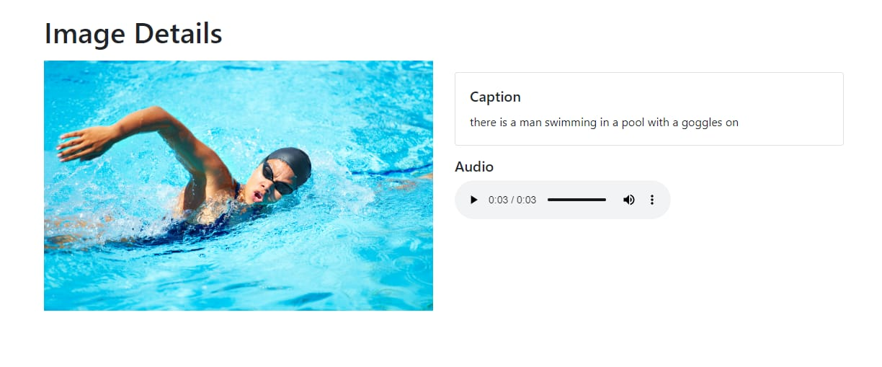
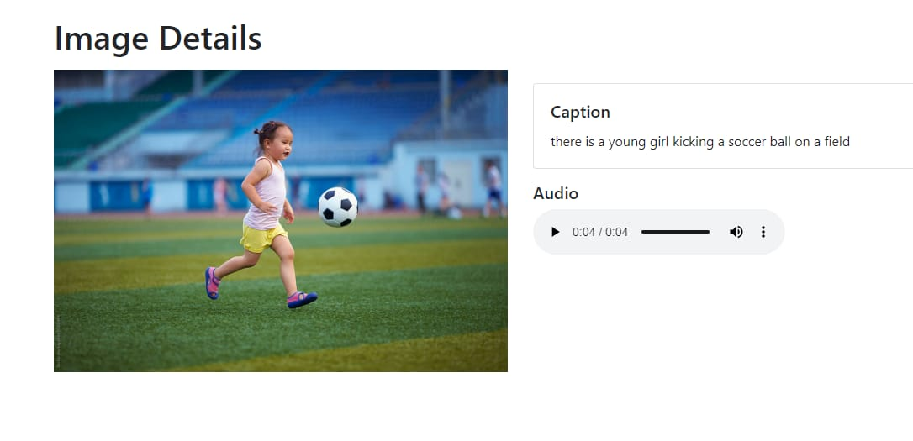
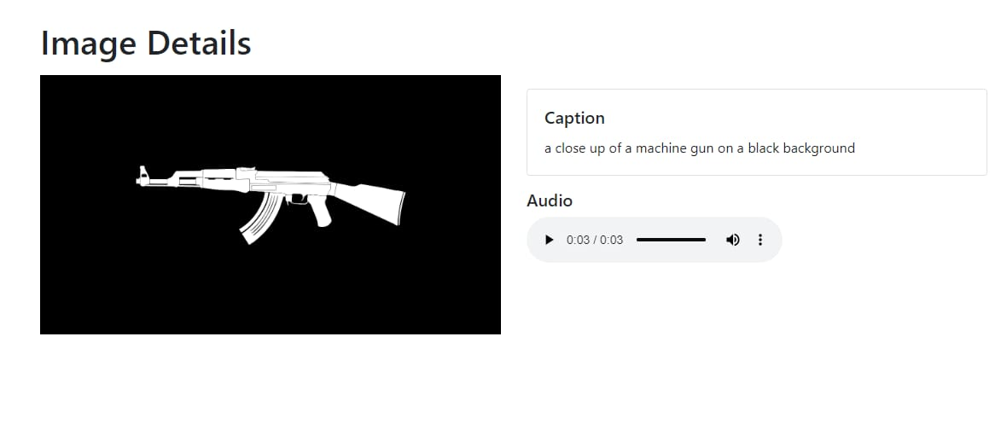
Output

Slide 9
Conclusion
project successfully addresses the challenge of automatically generating descriptive captions for images.
The integration of a user-friendly interface enhances accessibility and encourages future development opportunities.
Show how the image caption generator may be used in practical situations, such as content development, accessibility, and creative exploration.
The image caption generator becomes a handy tool that makes things easier, more inclusive, and sparks creativity.

Slide 10
References
International Journal of Innovative Technology and Exploring Engineering (IJITEE) ISSN: 2278-3075 (Online), Volume-10 Issue-3, January 2021, Megha J Panicker, Vikas Upadhayay, Gunjan Sethi, Vrinda Mathur.
International Journal of Engineering Research & Technology (IJERT) ISSN: 2278-0181IJERTV10IS110121 (This work is licensed under a Creative Commons Attribution 4.0 International License.)Vol. 10 Issue 11, November-2021
Visual Image Caption Generator Using Deep Learning by Grishma Sharma, Priyanka Kalena, Nishi Malde, Aromal Nair.
Image Caption Generator Using Deep Learning by Palak Kabra, Mihir Gharat, Dhiraj Jha, Shailesh Sangle , Paper Id: IJRASET47058 ,Publish Date : 2022-10-11,ISSN : 2321- 9653
Image Caption Generator using Deep Learning , by M. Sailaja; K.Harika; B.Sridhar; RajanSingh; V.Charitha; Koppul a Srinivas Rao.
Image caption generation using Visual Attention Prediction and Contextual Spatial Relation Extraction On Published: 08 February 2023
Automatic Image Caption Generation Using Deep Learning Akash ,Arun Kumar Yadav ,Mohit Kumar
Research Paper On Image Caption Generator Using Deep Learning Authors:Aryan Chauhan, Abhinav Beniwal, Nishant Ahlawat, Avi Panwar 22-12-31.

Slide 11

Thank You!

